Slide 1
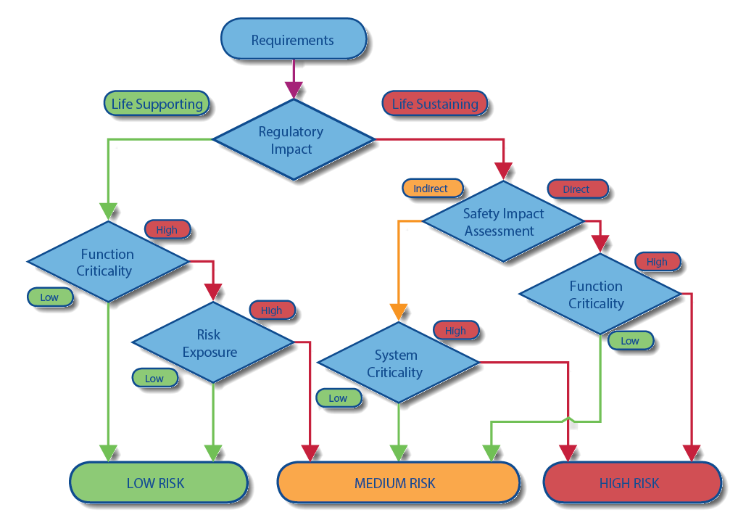
Test Plan assessment
Identifying, mitigating and minimizing potential hazards
Evaluate criticality by virtue of design
Rationalization based on level of Risk
“Cell Show”
“H-Monitor”
“Read Me”

Slide 2
Test Plan Synopsis
Basis on cyclomatic complexity
System Integration testing
Hardware and software

